Slide 1
2024
Software Development Life Cycle
Page
01

Slide 2
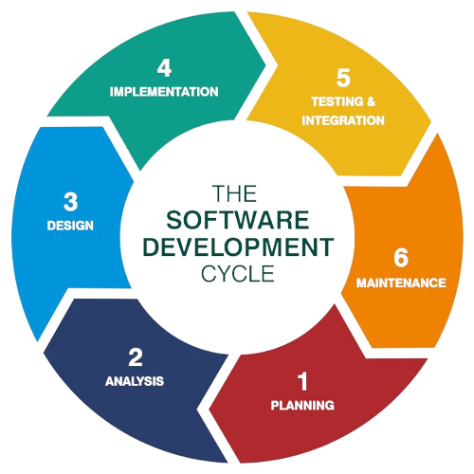
2024
What is SDLC?
The software development life cycle (SDLC) is the process of developing software, including planning, designing, coding, testing, and maintaining.
The goal of the SDLC life cycle model is to deliver high-quality, maintainable software that meets the user’s requirements.
Page
02

Slide 3
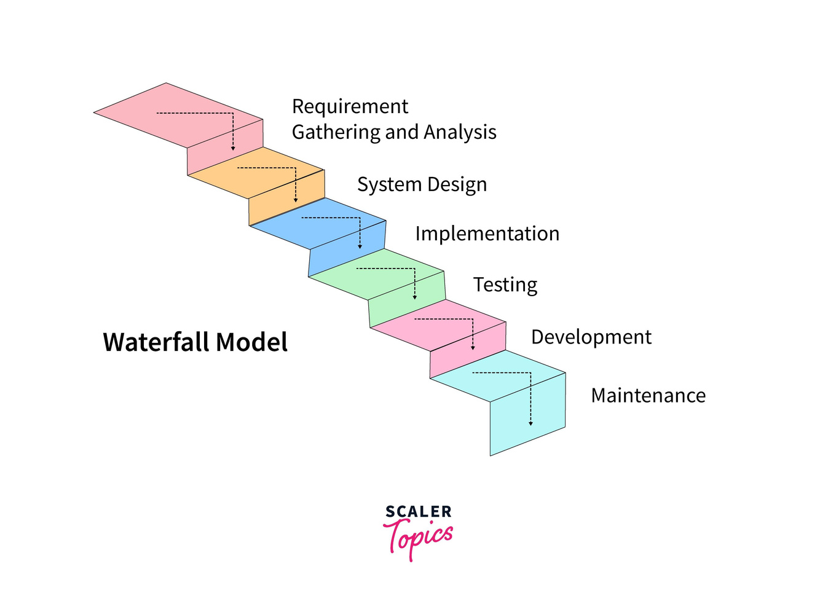
2024
Waterfall Model
Overview
The waterfall model is a linear, sequential approach to the SDLC .
The waterfall model is similar to the direction of water that flows over the edge of a cliff.
Drawbacks
Once requirements are set, they cannot be easily modified.
There is no room for incorporating feedback during the process.
Changes in requirements require restarting the entire project.
Page
03

Slide 4
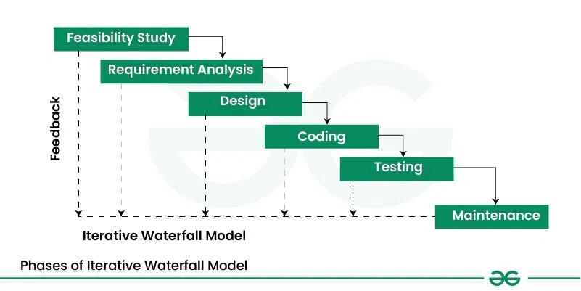
2024
Iterative Model
Overview
Traditional Waterfall steps with iterative flexibility.
Improvements can be made throughout the process, not just at the end.
Each phase has feedback paths to the preceding phase.
Adjustments can be made mid-process, unlike the rigid classical model.
Drawbacks
Limited customer interactions
Overlapping of phases not supported
Page
04

Slide 5
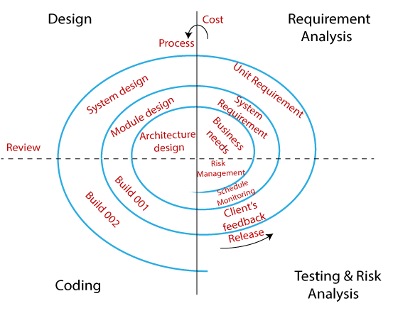
2024
Spiral Model
Overview
Iterative development + risk management.
The development process passes through multiple spirals, each representing a phase.
Risks are identified and addressed at each iteration and then risk mitigation is performed accordingly
Drawbacks
Managing risk and constant iterations can make the process complex.
Due to its detailed risk management and multiple iterations, spiral model can be costlier.
Page
05

Slide 6
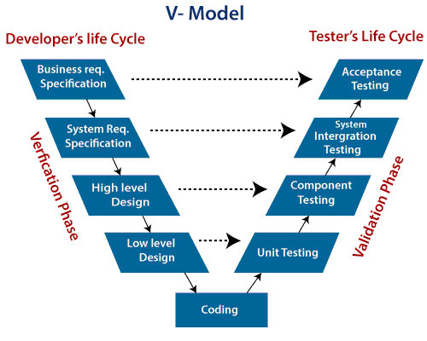
2024
V Model
Overview
In V Model, each development phase has a corresponding testing phase.
Defects are identified early as testing starts alongside development.
The process flows downwards for development and upwards for testing, forming a V shape.
Drawbacks
Once a phase is completed, going back to make changes is difficult.
It is challenging to incorporate changes or new requirements once a phase is completed.
Page
06

Slide 7
Thank You

